Slide 1
Krista Maxson, PhD
Associate Vice Chancellor, P-16 Initiatives
kmaxson@highered.ohio.gov
Pamela Greene, PhD
Director, Educator Preparation
pgreene@highered.ohio.gov

Slide 2
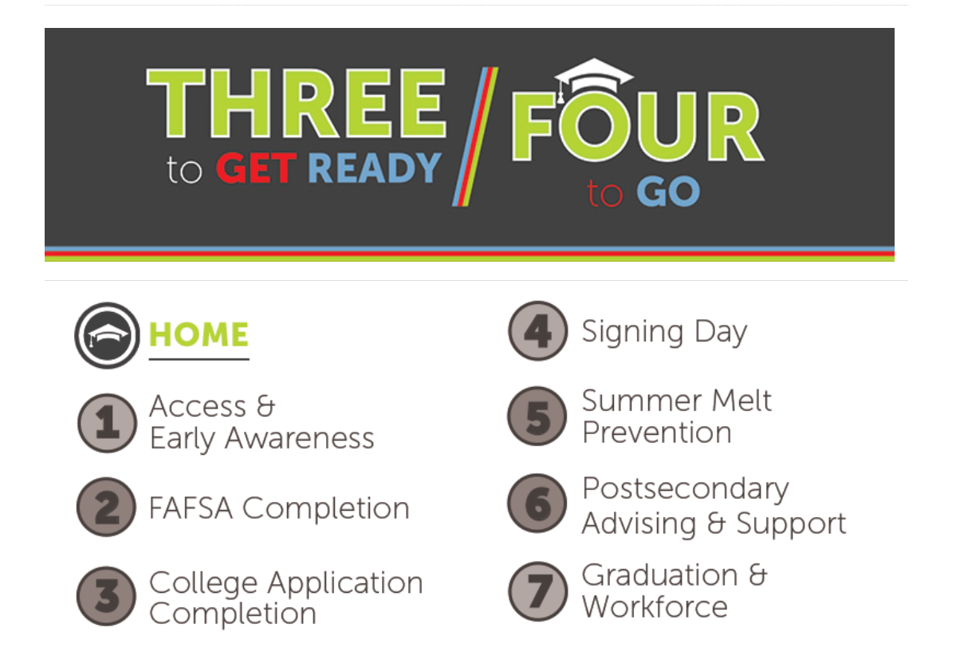
3 to get Ready / Four to Go
  October is
  FAFSA
  completion
  month
    2021 FAFSA
    Completion
    down 4.7%
    In Ohio
    down 9.3%
    in Ohio high
    minority
    serving HS

Slide 3
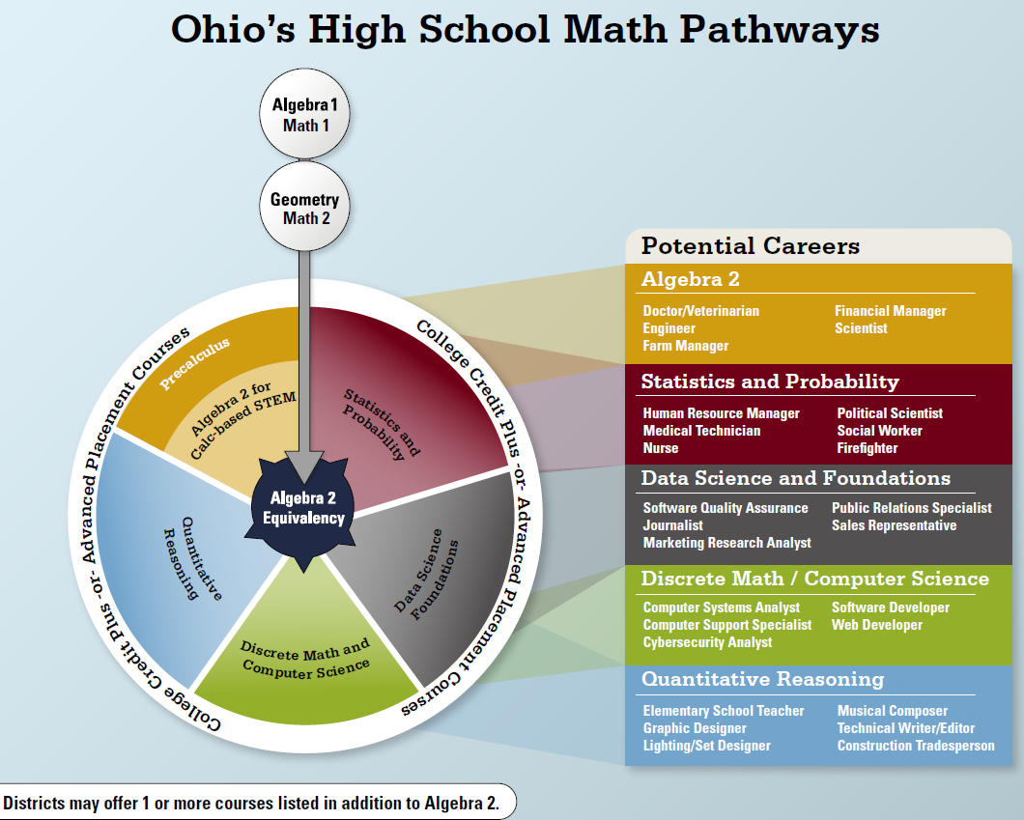
Strengthening Ohio’s HS Math Pathways
Virtual Symposium
Nov. 9-10, 2021 4:00-7:30pm

Slide 4
HB 110 Computer Science update
Panel of computer scientists, Ed Prep faculty, ODE, and ODHE staff meeting.
Breaking into teams to address recommendations via grade bands:
  Primary (PK-5)
  Middle Childhood (4-9)
  Adolescent Young Adult (7-12)
  Multi-Age (PK-12)

Slide 5
Diversifying the Education Profession Advisory Council
ODE’s Office of Educator Effectiveness,
  Director Yenetta Harper
  collaborative effort that has multiple workgroups one being the….
Higher Education Workgroup
  Conduct survey to prepare an inventory of what is happening in state
  Survey was sent end of June and was open through August to collect information
  Workgroup has reviewed preliminary results

Slide 6
Program Review Update – Fall 2021
Manual and Forms posted on website:
  Working Manual Draft – Review Process
  Form Sections 1 & 2 – Common Elements
  Form Section 3 – Teacher, Professional Administrator, and Pupil Services Programs
  Form Section 4 – Endorsements
  Form Section 5 – Associate Licenses
  Fall submissions due date: October 15, 2021
    Submit to: EdPrep@highered.ohio.gov

Slide 7
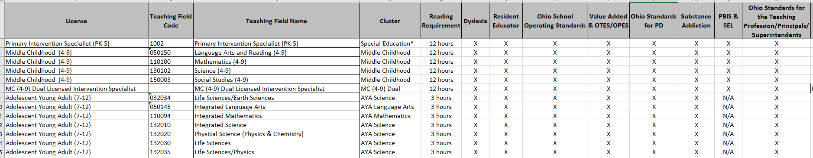
Ohio Specific Requirements
  https://www.ohiohighered.org/educator-preparation/institutions
  Chart link takes you to table that lists licensure programs, cluster(which panel) and notes the Ohio requirements.

Slide 8
Lean Ohio
Assists organizations in reviewing processes & related procedures for efficiency & effectiveness
Identify waste: practices with potential for greater efficiency
Aspects of processes explored by Lean:
preparation, training, support, delivery
It might tweak the process

Slide 9
Lean Ohio
Multi-week process → currently halfway through
Involves Ed Prep staff & IHE stakeholders: CUSTOMERS
EPP faculty & staff who participate in program review
regular cycles

Slide 10
Lean Ohio & Future Program Review
Some adjustments to the program review process
Streamlining
Possible reduced number of steps for EPPs submitting programs
Possible adjustments to training of chairs, panel members, & EPP faculty who prepare programs
Other possible adjustment TBD as Lean continues
MOST IMPORTANT TAKEAWAY FOR EPPs!
Any changes resulting from Lean will
NOT GO INTO EFFECT BEFORE AY 2022-2023

Slide 11
Some Frequent Questions!
When submitting endorsements, is it possible to provide one set of common elements or does each endorsement need its own common elements?
When submitting programs that overlap, is a single statement explaining the overlap sufficient? What should be included in that statement?
Will possible rule changes impact future submissions of dual programs? What will the impact look like?

Slide 12
Ways to Be in Touch with Ed Prep!
We know that questions come up all of the time. If your questions were not asked & answered during today’s update, please contact Krista and/or me at our e-mail addresses below or via the Ed Prep mailbox.
kmaxson@highered.ohio.gov
pgreene@highered.ohio.gov
EdPrep@highered.ohio.gov
We Look Forward to Hearing from &
Our Continued Collaboration!

